Slide 1
Command line

Slide 2
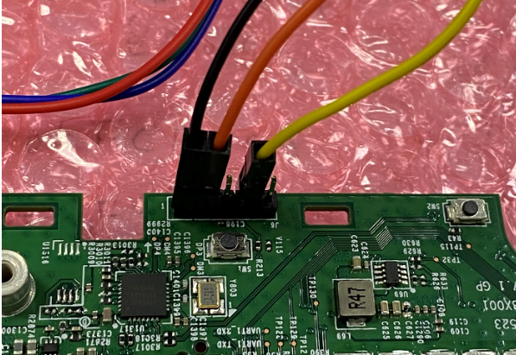
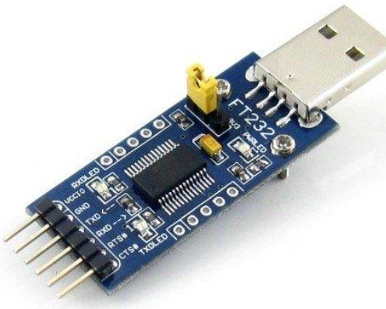
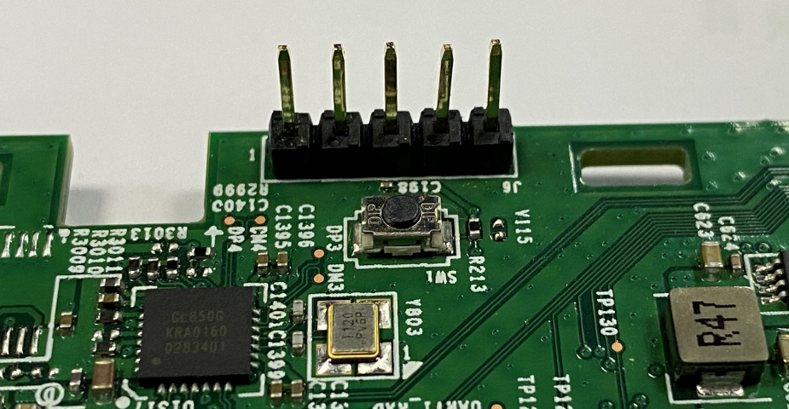
Console Pin Definition
Connect console
Ground
Tx
Rx
1
2
3
4
5
1
GND
4
RX
2
TX
5
GND
3
3.3V

Slide 3
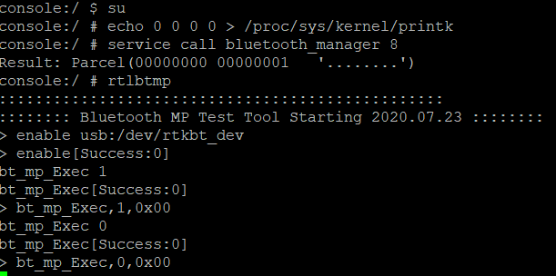
Direct Test Mode
Su
echo 0 0 0 0 > /proc/sys/kernel/printk
service call bluetooth_manager 8 // Disable BT Service
rtlbtmp
enable usb:/dev/rtkbt_dev
bt_mp_Exec 1 // enable test mode
bt_mp_Exec 0 // (HCI Reset) stop test

Slide 4
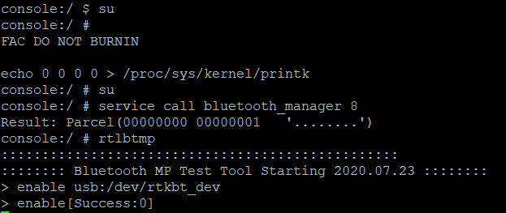
BR/EDR continue TX test
When testing another set of bt_mp_SetParam, must to input stop command first
Initial Command
su
echo 0 0 0 0 > /proc/sys/kernel/printk
service call bluetooth_manager 8 // Disable BT Service
rtlbtmp
enable usb:/dev/rtkbt_dev
Enable success
bt_mp_SetParam 1,0;2,0x02;3,0x05;4,0x00;6,0x7F;7,0x00;9,0xA078;11,0x000000c6967e //channel 0 (2402MHz),DH5
bt_mp_SetParam 1,0;2,0x05;3,0x05;4,0x00;6,0x7F;7,0x00;9,0x3F870;11,0x000000c6967e //channel 0 (2402MHz),2DH5
bt_mp_SetParam 1,0;2,0x08;3,0x05;4,0x00;6,0x7F;7,0x00;9,0xA078;11,0x000000c6967e //channel 0 (2402MHz)，3DH5
bt_mp_SetParam 1,39;2,0x02;3,0x05;4,0x00;6,0x7F;7,0x00;9,0xA078;11,0x000000c6967e //channel 39 (2441MHz)，DH5
****************************************************
bt_mp_Exec 34 //start tx 30 for FW_packet tx
bt_mp_Exec 35 //stop tx 31 for FW_packet tx stop

Slide 5
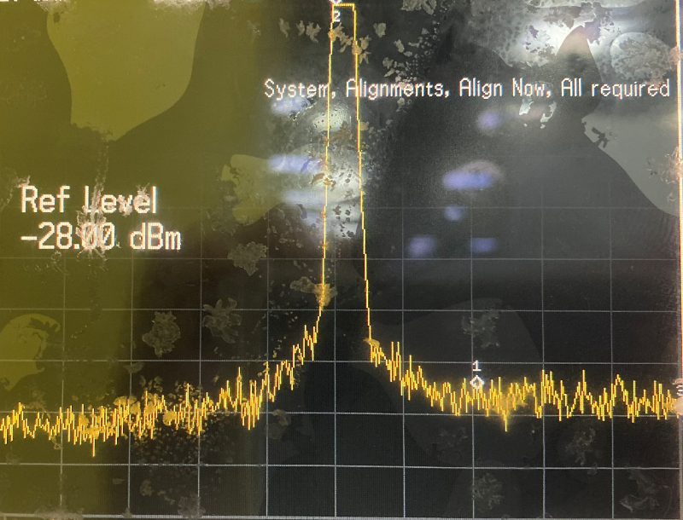
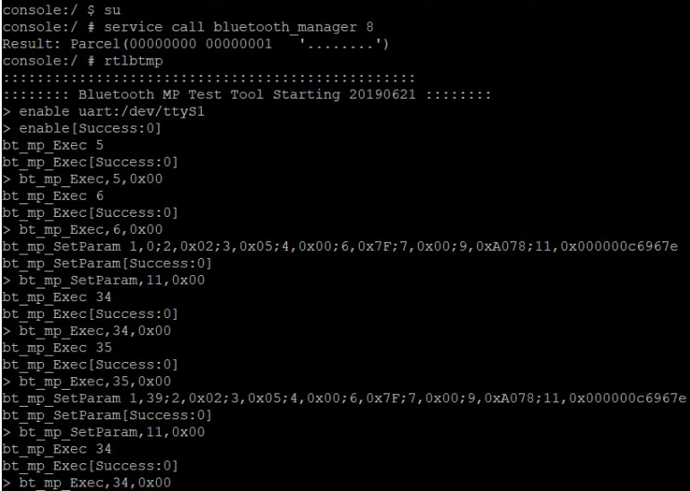
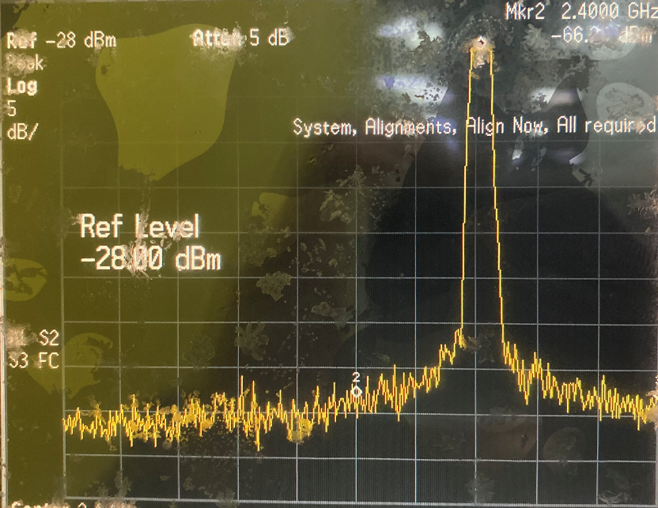

Slide 6
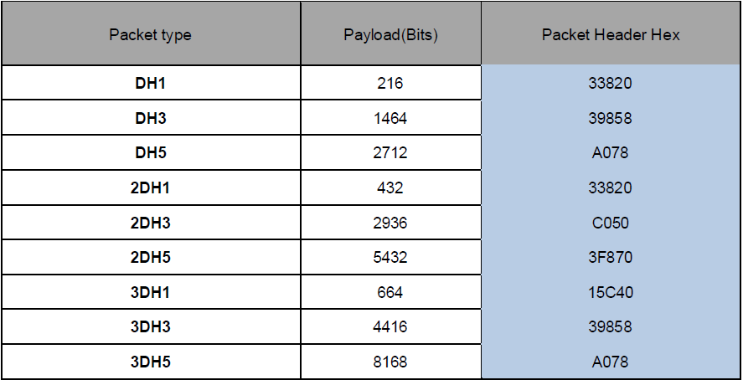
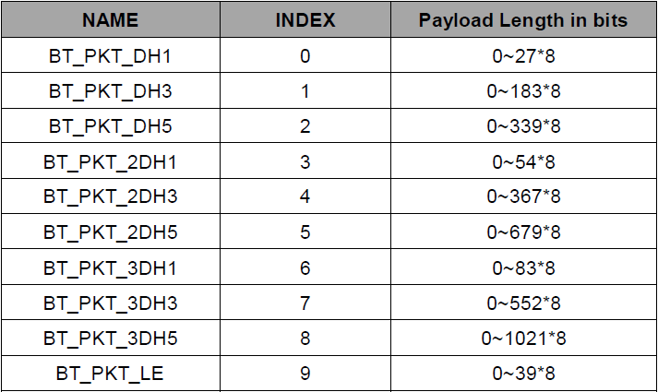
a
b
c
bt_mp_SetParam 1,0;2,0x02;3,0x05;4,0x00;6,0x7F;7,0x07;9,0xA078;11,0x000000c6967e
a
ChannelNumber → value range : 0~78
c
PacketHeader
b
PacketType

Slide 7
Sigle Tone Tx Mode
bt_mp_SetParam 1,0;2,0x08;3,0x00;6,0xFF;7,0x00;9,0x3FFFF;11,0x000000c6967e
//channel 0 3DH5 single tone tx mode
Bt_mp_SetParam 1,39;2,0x08;3,0x00;6,0xFF;7,0x00;9,0x3FFFF;11,0x000000c6967e
//channel 39 3DH5 single tone tx mode
bt_mp_SetParam 1,78;2,0x08;3,0x00;6,0xFF;7,0x00;9,0x3FFFF;11,0x000000c6967e
//channel 78 3DH5 single tone tx mode
****************************************************
bt_mp_Exec 34 //start tx
bt_mp_Exec 35 //stop tx

Slide 8
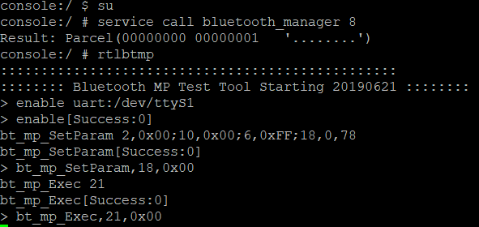
Hopping test
bt_mp_SetParam 2,0x00;10,0x00;6,0xFF;18,0,78 // DH5
bt_mp_SetParam 2,0x05;10,0x00;6,0xFF;18,0,78 //2DH5
Bt_mp_SetParam 2,0x08;10,0x00;6,0xFF;18,0,78 // 3DH5
bt_mp_SetParam 2,0x09 // BLE
**************************************************
bt_mp_Exec 21 //start
bt_mp_Exec 0 //stop

Slide 9
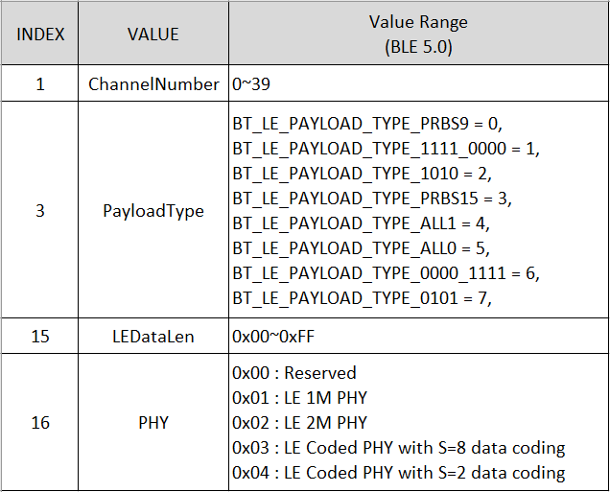
BLE5.0 TX test (1M)
bt_mp_SetParam 1,0;3,0x00;15,0xff;16,1 //channel 0 (2402MHz)，BLE
bt_mp_SetParam 1,19;3,0x00;15,0xff;16,1 //channel 19 (2421MHz)，BLE
bt_mp_SetParam 1,39;3,0x00;15,0xff;16,1 //channel 39 (2441MHz)，BLE
********************************************
bt_mp_Exec 22 //LE TX TEST
bt_mp_Exec 24 //LE TEST END

Slide 10
BLE5.0 TX test (2M)
bt_mp_SetParam 1,0;3,0x00;15,0xff;16,2 //channel 0 (2402MHz)，BLE
bt_mp_SetParam 1,19;3,0x00;15,0xff;16,2 //channel 19 (2421MHz)，BLE
bt_mp_SetParam 1,39;3,0x00;15,0xff;16,2 //channel 39 (2441MHz)，BLE
********************************************
bt_mp_Exec 22 //LE TX TEST
bt_mp_Exec 24 //LE TEST END

Slide 11
BLE TX test _ ch0－39 */ 2,0x09=PRBS9
bt_mp_SetParam 1,0;2,0x09;3,0x30;4,0x00;7,0x00;15,0x25 //channel 0 (2402MHz)，BLE
bt_mp_SetParam 1,19;2,0x09;3,0x30;4,0x00;7,0x00;15,0x25 //channel 19 (2421MHz)，BLE
bt_mp_SetParam 1,39;2,0x09;3,0x30;4,0x00;7,0x00;15,0x25 //channel 39 (2441MHz)，BLE
********************************************
bt_mp_Exec 36 //start tx
bt_mp_Exec 37 //stop tx

Slide 12
BLE Single Tone
bt_mp_SetParam 1,0;2,0x09;3,0x00;6,0xFF;7,0x00;9,0x3FFFF;11,0x000000c6967e //channel 0 BLE single tone tx mode
bt_mp_SetParam 1,19;2,0x09;3,0x00;6,0xFF;7,0x00;9,0x3FFFF;11,0x000000c6967e //channel 19 BLE single tone tx mode
bt_mp_SetParam 1,39;2,0x09;3,0x00;6,0xFF;7,0x00;9,0x3FFFF;11,0x000000c6967e //channel 39 BLE single tone tx mode
****************************************************
bt_mp_Exec 36 //start LE tx
bt_mp_Exec 37 //stop LE tx

Slide 13
RX test / by No-Signaling /PRBS9 payload_type
bt_mp_SetParam 1,0;2,0x00;3,0x07;6,0xFF;9,0x33820;11,0x000000c6967e //channel 0,DH1
bt_mp_SetParam 1,39;2,0x02;3,0x07;6,0xFF;9,0xA078;11,0x000000c6967e //channel 39,DH5
bt_mp_SetParam 1,39;2,0x05;3,0x07;6,0xFF;9,0x3F870;11,0x000000c6967e //channel 39,2DH5
bt_mp_SetParam 1,78;2,0x08;3,0x07;6,0xFF;9,0xA078;11,0x000000c6967e //channel 78,3DH5
bt_mp_Exec 32 //start rx
bt_mp_Report 3
//Report Received Result /format RxRssi,RXBits,RxCounts,RxErrorBits/ “bt_mp_Report 3” should be executed every 1s.
bt_mp_Exec 33 //stop rx

Slide 14
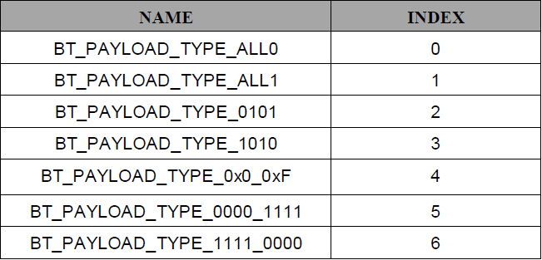
BLE RX test /Measure the DUT BLE Rx sensitivity
bt_mp_SetParam 1,0;3,0x07 //ch0,Payload Type:PRBS9
bt_mp_SetParam 1,0;2,0x09;3,0x07 //ch0,Payload Type:PRBS9
bt_mp_Exec 23 //Run LE_RX_DUT_test
bt_mp_Exec 24 //LE_RX_DUT_Test_End; stop LE packet RX and to obtain the receive packet count
k
bt_mp_Report 11 //Rx RxCounts
--------------------------------------------------------------------------------------------------------------------------------------------------------------------
bt_mp_SetParam 1,0;2,0x09;3,0x07

Slide 15
Adjust Tx Power By Command
Notice: If DUT restart and need to set power value again
Get TX power level
bt_mp_Exec 38
bt_mp_Report 17
Set TX power level to ram: Default (1M=0x3C);(2M=0x43);(3M=0x43),(BLE=0x3C)
bt_mp_SetParam 18,0x3C,0x43,0x43,0x3C,0x3C;
bt_mp_Exec 51
BT 1M
BT 3M
LE 2M
BT 2M
LE 1M
BT1M
BT2M
BT3M
LE1M
LE2M

Slide 16
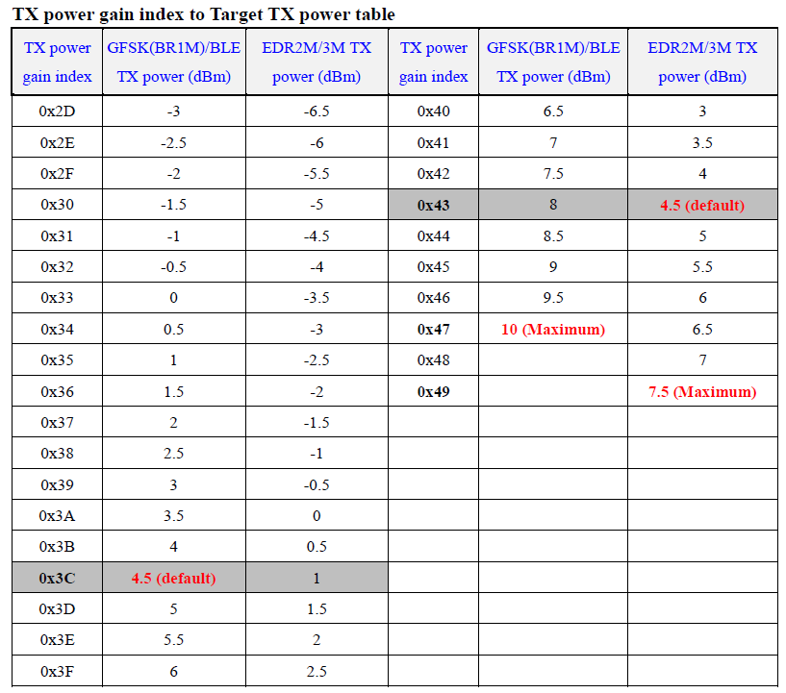
Tx Power Table

